Slide 1
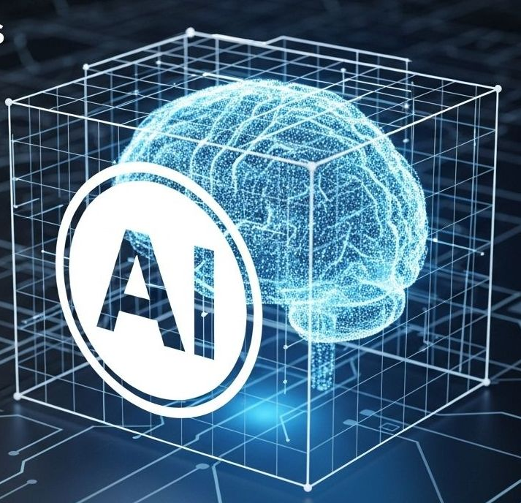
ALY3510 - Fall 2026
Lecture 6:
Natural Language Processing (NLP)

Slide 2
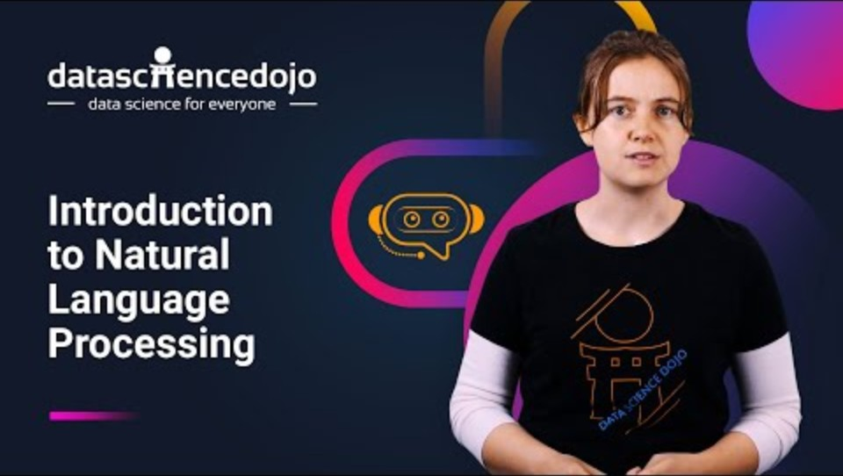
Pre-Lecture Video (2:54) - Introduction to Natural Language Processing
https://www.youtube.com/watch?v=f5bqPOkOJs4

Slide 3
Agenda
Pre-lecture video
Lecture SECTIONS:
  Embeddings
  Sequence Models
  Machine Translation
  Transformers
  NLP in the Real World
In-class discussion
Notes:
.

Slide 4
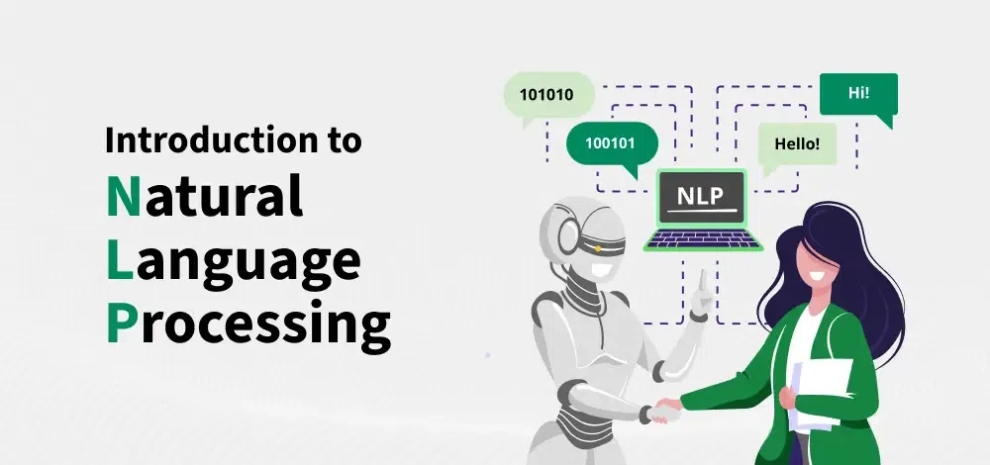
What is NLP & Why It Matters
A branch of AI that enables computers to understand, interpret, and generate human language.
Natural communication
Knowledge access
Scale & speed
Interact with computers using language, not code
Unlock meaning from books, web, documents
Process millions of documents in seconds
NLP has evolved from rule-based systems to neural models that understand context and generate human-like text.
https://www.geeksforgeeks.org/nlp/introduction-to-natural-language-processing/

Slide 5
Modern NLP Applications & Tasks
Modern NLP learns contextual understanding from massive text corpora — approaching human-like interpretation.
Key Takeaway: NLP has evolved from rule-based systems to powerful neural models that understand context and generate human-like text.
Applications you use daily
Core NLP tasks
Conversational AI — ChatGPT, Claude
Translation — Google Translate, DeepL
Voice assistants — Siri, Alexa
Search, recommendations, content generation
Code assistants — Copilot, Cursor
Speech recognition
Machine translation
Question answering
Sentiment & text analysis
Summarization & information extraction

Slide 6
The NLP Pipeline: From Text to Understanding
Raw text
the messy input
Preprocess
clean & normalize
Tokenize
split into tokens
Embed
tokens → vectors
Model
RNN/Transformer
Application
answer, translate…
Example — “The Cats Are Sleeping on the Couch”
Preprocess → “the cats are sleeping on the couch” (lowercased; stop words kept)
Tokenize → [“the”, “cats”, “are”, “sleep”, “ing”, “on”, “the”, “couch”] (1 word → 2 tokens)
Embed → each token becomes a vector of numbers the model can process

Slide 7
Preprocessing & Tokenization
Preprocessing — clean the data
Tokenization — split into tokens
Lowercasing and stop-word removal are classic steps for bag-of-words and TF-IDF models. Modern LLMs skip them and use subword tokens, which handle rare and made-up words.
Lowercase everything
Remove punctuation, URLs, emojis
Remove stop words (“the”, “is”, “at”)
Normalize — consistent formatting
Break text into words, subwords, or characters
Tokens are the units that models actually process
“playing” → [“play”, “ing”] (subword pieces)
Foundation of everything downstream

Slide 8
Preprocessing & Tokenization - Example
A noisy sentence shrinks to five tokens, following the pipeline order from slide 6.
Experiment with an interactive tokenizer.
Raw text
Wow!! NLP chatbots are SO cool :) https://nlp.ai
1 Lowercase & clean
wow nlp chatbots are so cool
2 Tokenize
"wow"
"nlp"
"chat"
"bots"
"are"
"so"
"cool"
“chatbots” → 2 tokens
3 Remove stop words
"wow"
"nlp"
"chat"
"bots"
"are"
"so"
"cool"
5 tokens kept

Slide 9
Word Embeddings & Text Representation
Turning words into numbers that capture meaning

Slide 10
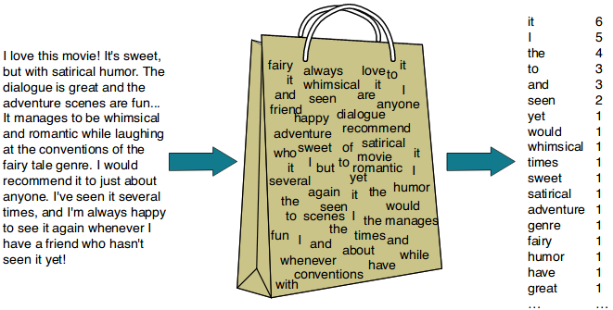
Bag of Words: A Simple Start
The Bag-of-Words model represents text by counting word occurrences — ignoring grammar and word order (like dumping words into a bag).
Advantages
Limitations
Simple to implement
Works for basic classification
Computationally efficient
Loses word order and context
No semantic meaning
“Not bad” looks like “bad not”
A useful baseline — but modern methods capture far richer meaning. Enter word embeddings.

Slide 11
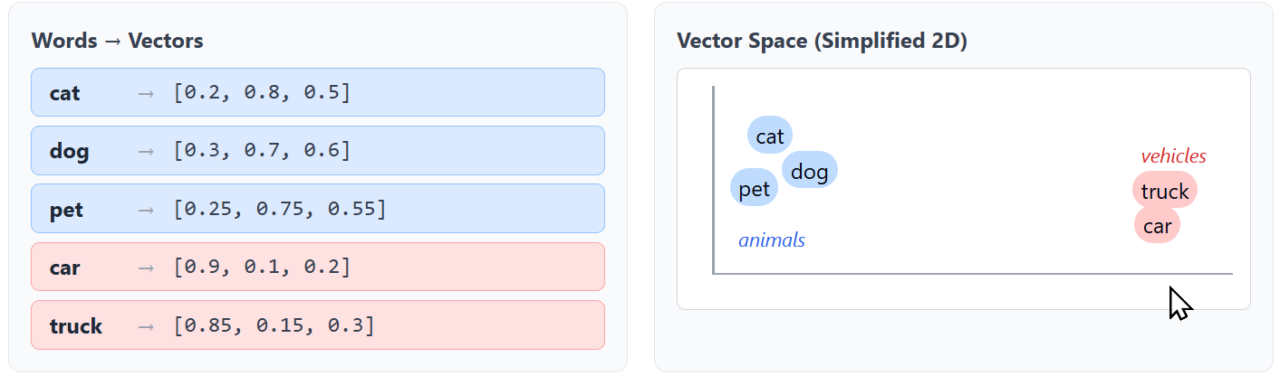
Words as Vectors
One-hot encoding: each word = a unique ID (a huge sparse vector). No meaning; wasteful.
Dense embedding: each word = a short list of numbers that captures its meaning.
Similar words get similar vectors — so they cluster together in “vector space.”
Similar words (cat, dog, pet) cluster together in vector space, while unrelated words (car, truck) form separate clusters — learned from data, not hand-coded.

Slide 12
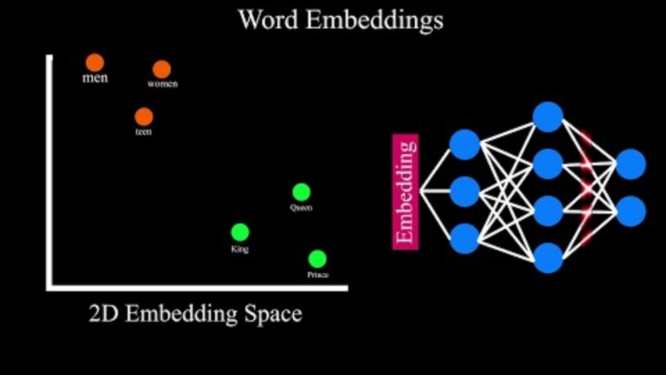
Word Vectors/Embeddings – Video (2:08)
https://www.youtube.com/watch?v=aWFllV6WsAs
Notes:
One of the AI breakthroughts

Slide 13
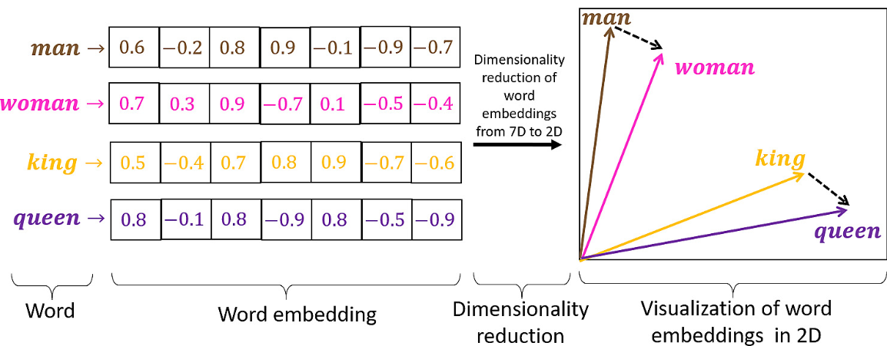
Word2vec & Vector Math
These relationships emerge automatically from training — capital cities, verb tenses, and gender, never explicitly taught.
“You shall know a word by the company it keeps” — word2vec learns meaning by predicting neighboring words.
Relationships become arithmetic:
Analogy | Vector math | Result
king : man :: queen : woman | king − man + woman | ≈ queen
Athens : Greece :: ? : Norway | Greece − Athens + Oslo | ≈ Norway (capital → country)
walk : walked :: run : ? | walked − walk + run | ≈ ran (verb tense)

Slide 14
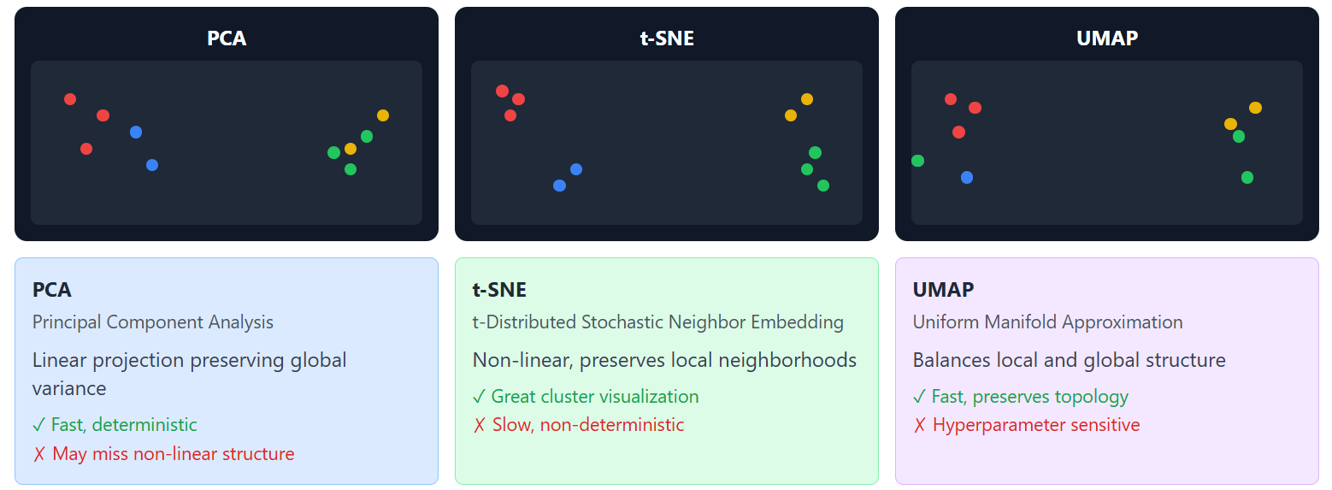
Visualizing Embeddings
Embeddings live in hundreds of dimensions. Projection techniques flatten them to 2D so we can see the clusters.
All three methods show the same thing: similar words cluster together — confirming embeddings capture meaning.
PCA
t-SNE
UMAP
Linear projection.
Fast, preserves global variance.
Non-linear. Great
for showing local clusters.
Balances local
and global structure.

Slide 15
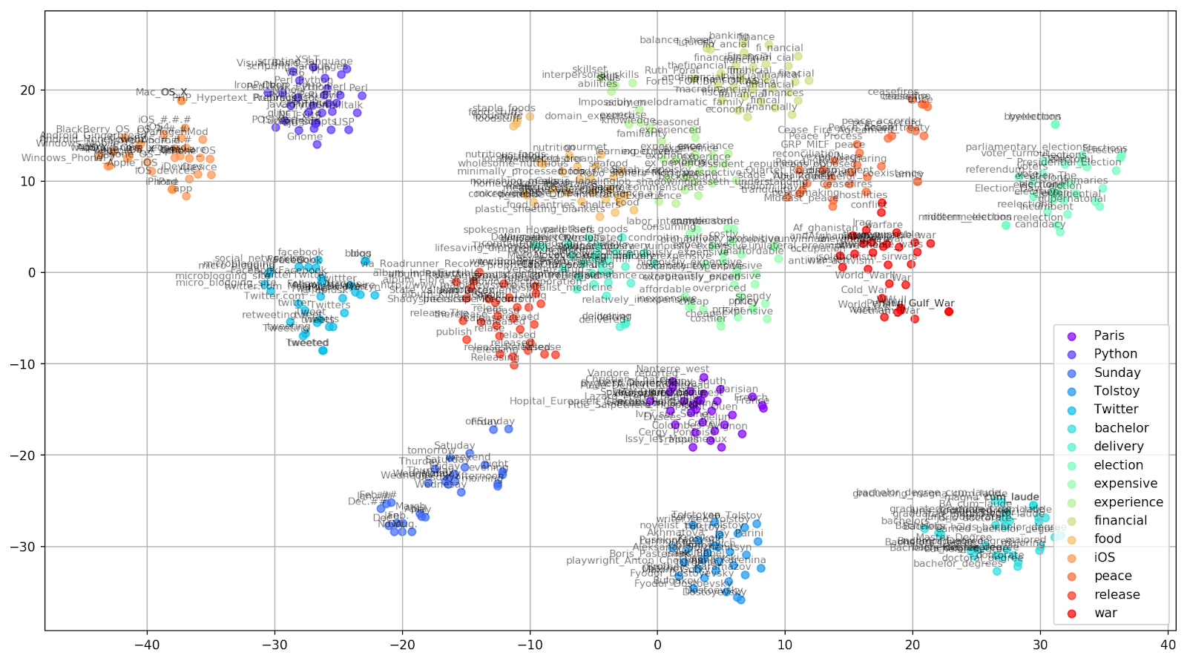
Visualization of Word Vectors (Example)
Using PCA, UMAP or e.g., t-SNE https://habr.com/en/company/mailru/blog/449984/

Slide 16
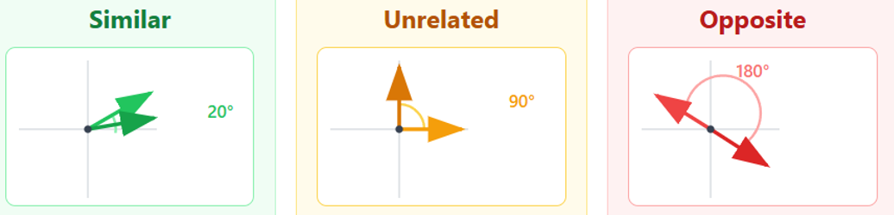
Cosine Similarity: Measuring Closeness
How similar are two words? Measure the angle between their vectors — same direction = similar; a right angle = unrelated.
The intuition
Real examples
Similar — small angle (≈ 1.0)
Unrelated — right angle (≈ 0)
Opposite — 180° (≈ −1.0)
cosine(“cat”, “dog”) = 0.76
cosine(“cat”, “computer”) = 0.17
Powers search, recommendations, clustering
Calculated with gensim's word2vec-google-news-300 model (Mikolov et al., 2013; Řehůřek & Sojka, 2010).
Cosine similarity is the workhorse behind semantic search and “find similar” everywhere.

Slide 17
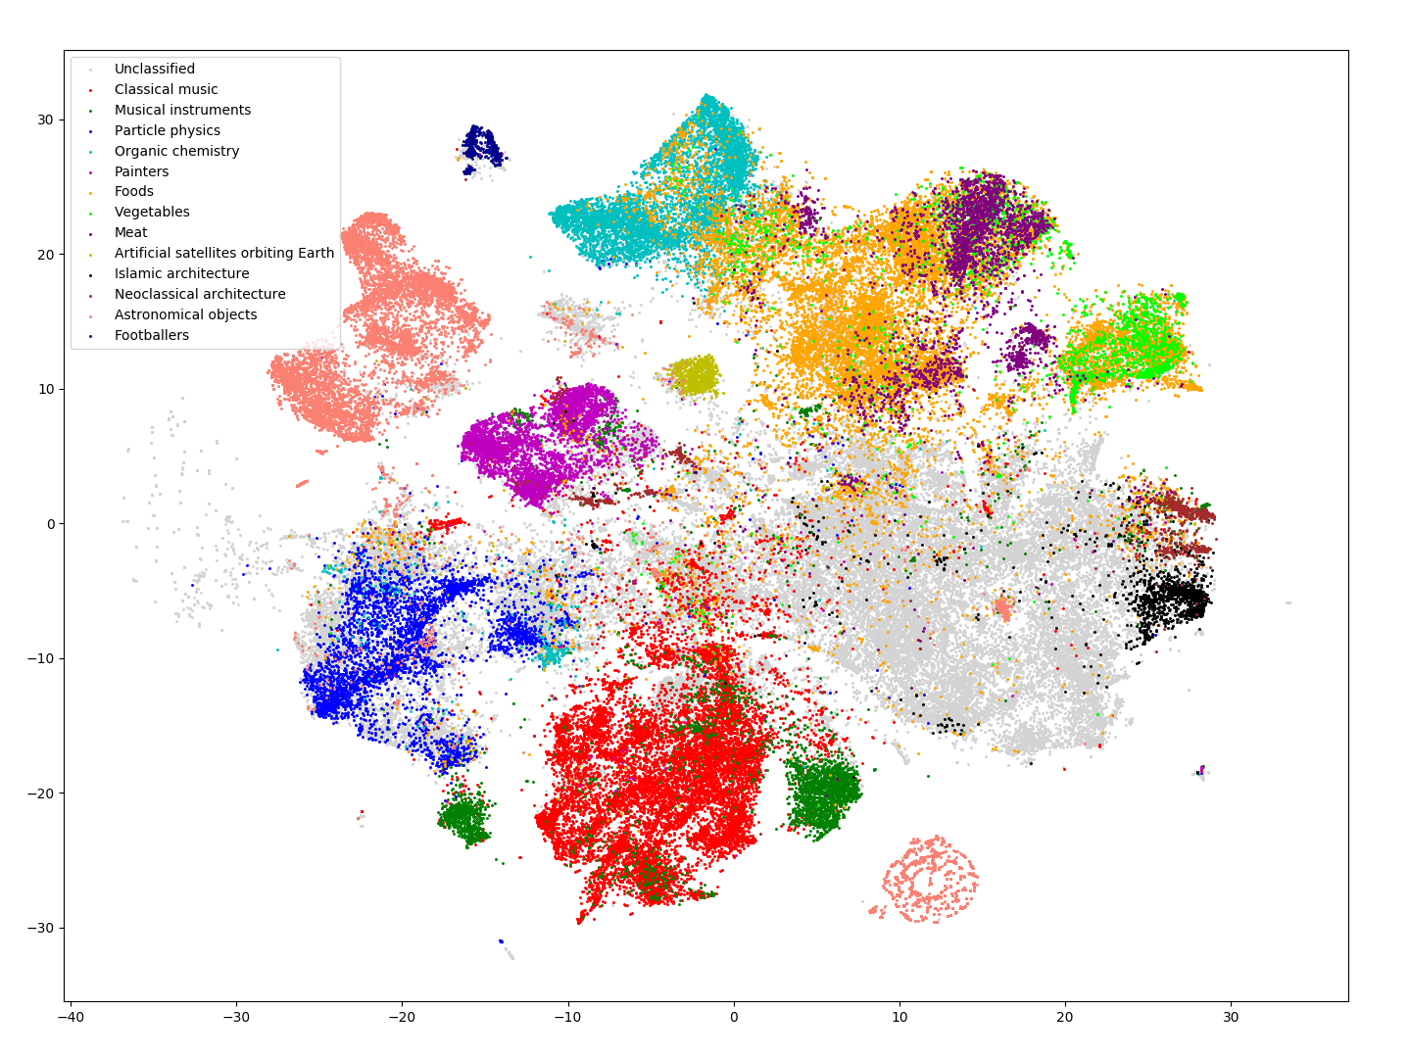
Sentence & Document Embeddings
Sentence embeddings capture the meaning of whole phrases — enabling semantic search and duplicate detection.
Doc2vec extends the idea to entire documents — articles, papers, web pages.
Visualizing 120k Wikipedia pages: physics articles cluster, sports articles cluster — no manual labeling.
Doc2vec projection of ~120k Wikipedia pages, grouped by subject.
https://graphaware.com/nlp/2018/09/03/advanced-document-representation.html

Slide 18
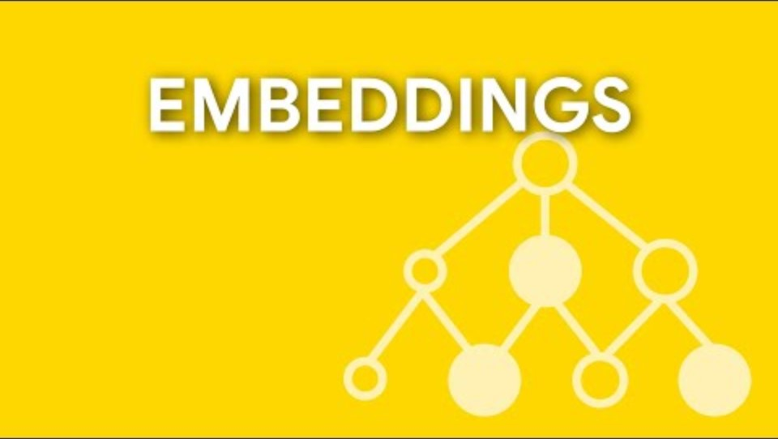
Embeddings – How-to Video (2:36)
https://www.youtube.com/watch?v=my5wFNQpFO0&t=2s

Slide 19
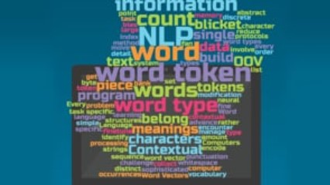
What does Word “Mean” in the Context? (3:54)

Slide 20
Sequence Models
Processing language as ordered sequences of words

Slide 21
Why Sequence Matters
Embeddings give each word a fixed vector — but a word’s meaning depends on the words around it, and the order they come in.
Context changes meaning
Order changes meaning
“I sat on the river bank.” → edge of a river
“I opened a bank account.” → a financial institution
Same word — the neighbors decide which meaning.
“Dog bites man.”
“Man bites dog.”
Same words, opposite meaning — a bag of words can’t tell them apart.
So we need models that read words in sequence and remember what came before — recurrent networks.

Slide 22
RNN & LSTM: Reading in Order
Recurrent networks read one word at a time, keeping a running “memory” (a hidden state) of what came before.
RNN — has memory
LSTM — gated memory
Reads word by word, left to right
Hidden state carries context forward
Problem: forgets early words in long sentences
Forget / input / output gates
Chooses what to keep vs. discard
Handles long-range dependencies
Introduced in Lecture 4; the key point for NLP: they read in order and carry context — but still one word at a time. Transformers fix that.

Slide 23
Machine Translation
Breaking language barriers with neural networks

Slide 24
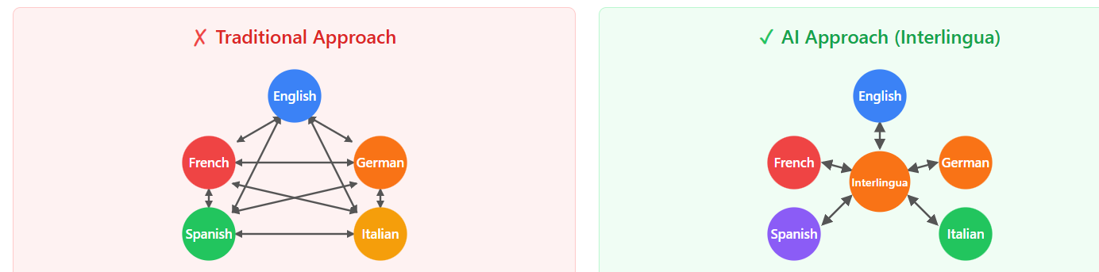
Encoder-Decoder & the Interlingua
Encoder reads the whole input sentence and compresses it into a “thought vector” — a language-independent meaning.
Decoder generates the output language from that thought vector, word by word.
Traditional approach
AI approach (interlingua)
A separate translator per language pair
5 languages → 20 models
100 languages → 9,900 models!
Translate to/from a shared meaning space
5 languages → 10 models; 100 → 200!
Enables zero-shot: pairs never trained

Slide 25
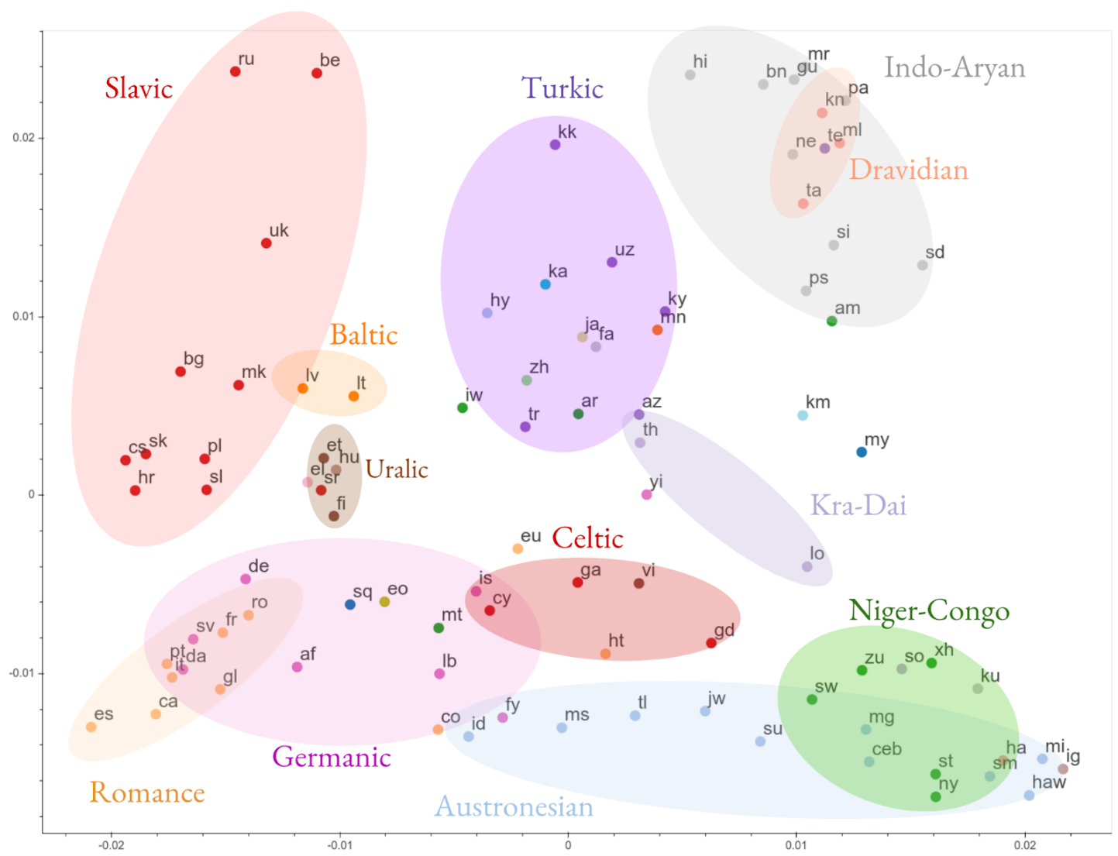
Translation – Vector Clustering by Language
Can help with rare languages whenever developing dedicated translators isn’t practical
Clusters show similar languages
https://ai.googleblog.com/2019/11/highlights-from-2019-google-ai.html

Slide 26
Transformers
"Attention is all you need" Vaswani et al., 2017

Slide 27
Self-Attention: The Key Idea
Self-attention lets each word look at ALL other words at once to decide which are most relevant to its meaning.
Experiment with the https://poloclub.github.io/transformer-explainer/
Word-sense disambiguation
Pronoun resolution
“I went to the bank to deposit money.”
Attention to “deposit” & “money” tells the model this is a financial bank — not a river bank.
“The animal didn’t cross the street because it was too tired.”
Attention resolves “it” → “animal.”
Self-attention captures long-range dependencies that RNNs struggle with — the key innovation behind modern LLMs.

Slide 28
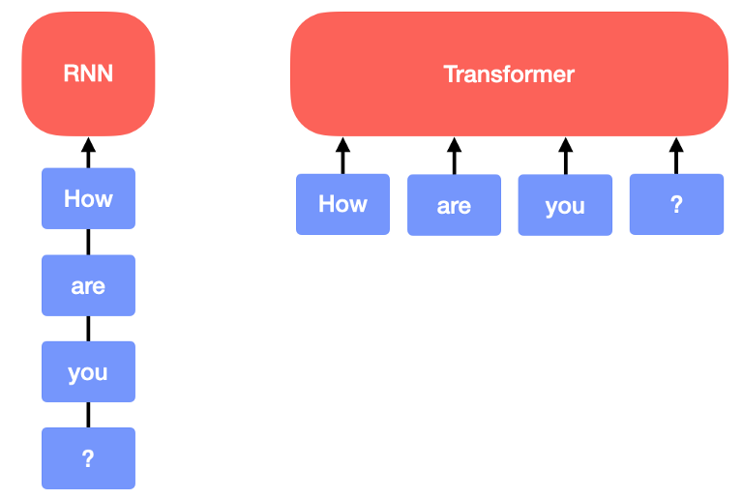
Transformer Architecture & Why It Won
Each layer = self-attention + feed-forward + residual/norm (not shown here)
Stack many layers — each adds a deeper level of understanding.
Depth of modern models: BERT ~12–24 layers · GPT-3 model has 96.
The breakthrough: process ALL words in parallel, not one at a time → training on massive data became feasible.
https://towardsdatascience.com/from-transformers-to-performers-approximating-attention-69c88af0b11f

Slide 29
AI vs. Human Performance: What Benchmarks Tell Us
Benchmark | Tests | Human baseline | Best AI today
GLUE | General language understanding | 87%¹ | Passed humans, 2019¹
SQuAD 1.1 | Reading comprehension | 91% (F1)² | Passed humans, 2018²
MMLU | Broad knowledge, 57 subjects | ~90% (experts)³ | 91.9% (several models)³
GPQA Diamond | Graduate-level science | 69.7% (PhD experts)⁴ | 96.3% (GPT-6 Astra)⁴
AIME 2025 | Competition mathematics | ~41% (qualifier average, 6 of 15)⁵ | 100% (several models)⁵
Where NLP stands: frontier models now beat the human baseline on every test here, and most are at or near saturation. Labs now report harder tests such as Humanity’s Last Exam and SWE-bench.
Human baselines from each benchmark’s original paper unless noted. Model scores checked October 17, 2026; results depend on evaluation setup.
¹ Nangia & Bowman (2019) human baseline 87.1; XLNet passed it at 88.4 in July 2019 (Wang et al., SuperGLUE, 2019). ² Rajpurkar et al. (2016), human F1 91.2; models passed it in Sept 2018 (AI Index 2021).
³ Hendrycks et al. (2021), expert estimate 89.8%. Model: GLM-4.5 report (arXiv 2508.06471).
⁴ Experts on Diamond: OpenAI o1 report (Sept 2024). Model: Artificial Analysis, 198 questions, no tools, Oct 2026.
⁵ AIME I+II 2025, 30 problems. Qualifier mean 6.16 (I) and 6.24 (II) of 15, 3 hours, no calculators (MAA via AoPS). Models: Mercor pass@1, Oct 2026.
Notes:
GLUE: nine tasks that test basic language understanding, such as sentiment, paraphrase and inference.
SQuAD 1.1: a reading-comprehension test where the model finds the answer to a question inside a Wikipedia passage.
MMLU: about 16,000 multiple-choice questions across 57 school and professional subjects, from math to law to medicine.
GPQA Diamond: 198 PhD-level science questions in biology, chemistry and physics, written so that a web search won't find the answer.
AIME 2025: the 30 problems from the 2025 American Invitational Mathematics Examination, a competition for top high-school students where each answer is a whole number from 0 to 999.

Slide 30
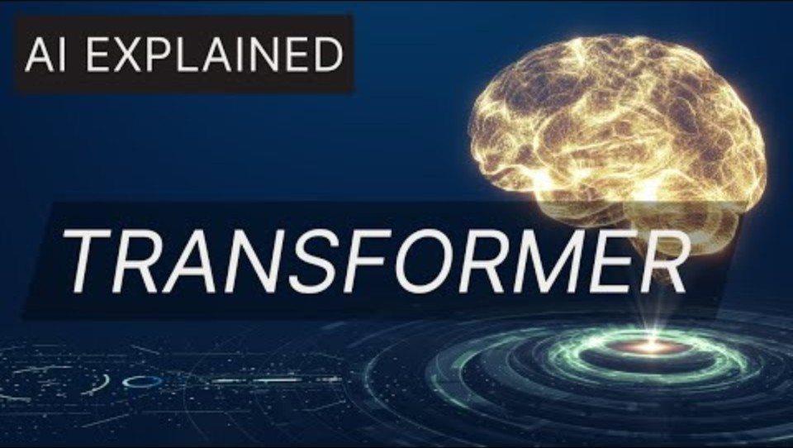
BREAK: Transformers – Video (2:06)
https://www.youtube.com/watch?v=ydMbcVLDeLE
Notes:
https://www.analyticsvidhya.com/blog/2019/06/understanding-transformers-nlp-state-of-the-art-models/

Slide 31
NLP in the Real World
From research breakthroughs to everyday tools

Slide 32
Chatbots & How LLMs Generate Text
A paradigm shift: from scripted responses to genuine language understanding at scale.
What modern chatbots do
How they write
Context retention across turns
Grasp intent from ambiguous phrasing
Use tools — search, databases, APIs
Fluent in 100+ languages
Auto-regressive: one token at a time
Each token predicted from all previous ones
“Just predicting the next word” — yet fluency & knowledge emerge from scale

Slide 33
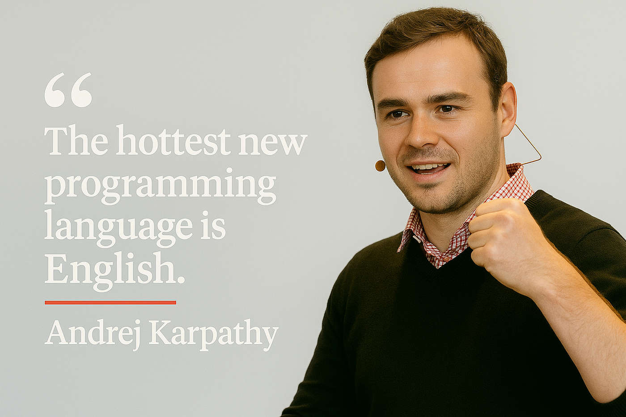

Code Generation & Retrieval-Augmented Generation
RAG — Retrieval-Augmented Generation: combine an LLM with an external knowledge source for accurate, up-to-date, private answers
"Vibe Coding": A new paradigm where developers describe intent in natural language, focusing on what to build rather than how to write it.

Slide 34
NLP Across Industries
Search & QA
Healthcare
Finance
Meaning-based search: answers, not just links.
~80% of records are unstructured (notes, reports, images)¹
Sentiment on news/earnings; fraud & compliance scanning.
Voice assistants
Summarization
Sentiment analysis
Speech → understand → respond; NLP is the brain.
Compress long documents to the key points.
Turn opinions into data — though sarcasm stays hard.
¹ Kong HJ. Managing Unstructured Big Data in Healthcare System. Healthc Inform Res. 2019 Jan;25(1):1-2. doi: 10.4258/hir.2019.25.1.1. Epub 2019 Jan 31. PMID: 30788175; PMCID: PMC6372467.

Slide 35
Summary

Slide 36
Key Takeaways
NLP bridges human–computer communication Natural language interaction, not code.
Words become vectors Embeddings capture meaning — enabling math on language.
Sequence → attention RNN/LSTM added memory; transformers added parallel attention.
Transformers changed everything Self-attention + scale power today’s LLMs.
Wide-ranging impact Search, healthcare, finance, code, voice — NLP is everywhere.

Slide 37
Let’s Discuss (5–10 min)
Word embeddings learn analogies like “king − man + woman ≈ queen” straight from text. If the training text carries human biases, what do the vectors learn — and where could that cause harm?
LLMs “just predict the next word,” yet write essays and code. Does that count as understanding language — or convincing imitation? Does the difference matter for how we use them?
Alternate: “The hottest new programming language is English. (Karpathy)” If describing intent replaces writing code, what skills become more — or less — valuable?

Slide 38
Advanced Subjects/Demos

Slide 39
Word Vectors/Embeddings - Demo
Word vectors numerically represent word semantics, including literal and implied meanings.
These vectors let us measure similarity and analogy. Which pair reflects more semantic similarity: “fish vs. shark” or “fish vs. fist”?
See the link to the demo Claude session exploring the semantic similarity of these and other subjects.
  Yourself: check the semantic similarity of:
    “feeling blue” vs. “feeling sad”
    “feeling blue” vs. “blue lagoon”

Slide 40
Optional Slides/Video for Self-Learning

Slide 41
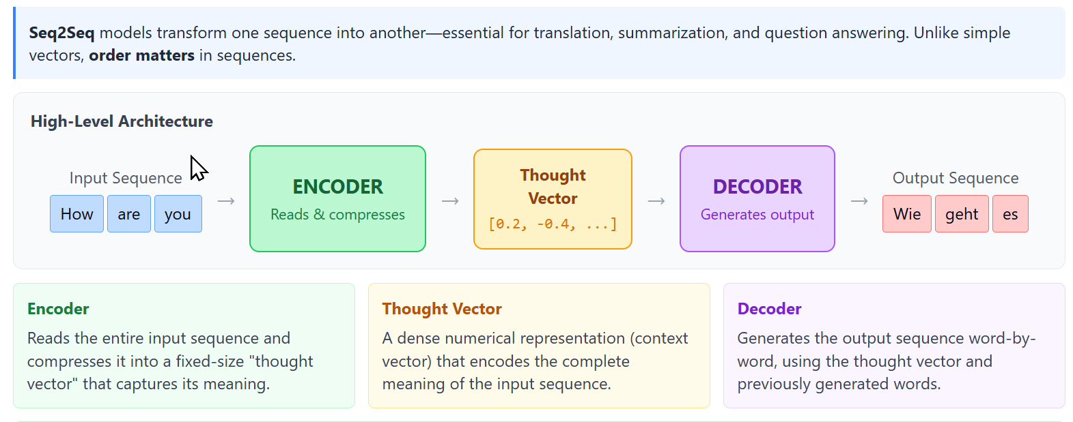
Sequence-to-Sequence Architecture
Seq2Seq models transform one sequence into another—essential for translation, summarization, and question answering. Unlike simple vectors, order matters in sequences.
Key Point: Seq2Seq enables variable-length input to variable-length output—"How are you?" (3 words) can become "Wie geht es dir?" (4 words) in German.

Slide 42
Recurrent Neural Networks (RNN)
Key Takeaway: RNNs process sequences by maintaining a hidden state that accumulates context word by word
Feedforward Network
Recurrent Network (RNN)
Sees everything at once.
Like looking at a photo.
Reads word by word, keeping
a running summary.
No loops • No memory
Loops back • Has memory
The
→
cat
→
sat
→
on
→
the
→
mat
Each word updates the hidden state — a running summary of everything read so far
Analogy: Reading a mystery novel page by page—each page updates your mental summary of the story.

Slide 43
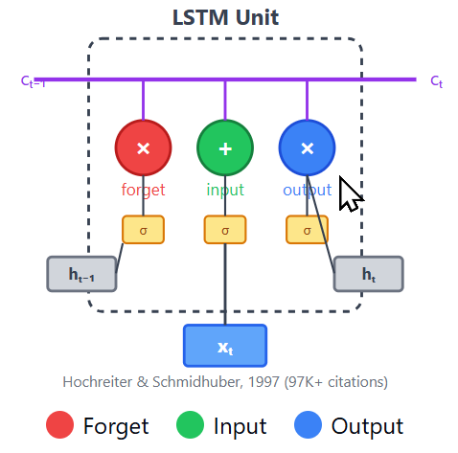
Long Short-Term Memory (LSTM)
Key Takeaway: LSTM’s gates selectively remember and forget, enabling it to handle long-range dependencies
The Problem: Basic RNNs forget early information in long sentences. LSTMs fix this with a structured memory system.
Forget Gate
Input Gate
Output Gate
What old info
to erase
What new info
to store
What info
to share
Example: "The athletes, who all won their local qualifiers and advanced to the finals in Tokyo, now compete." — LSTM remembers "athletes" is plural across 14 words to predict "compete“, not "competes."

Slide 44
LSTM vs. RNN: Architecture & Applications
Key Takeaway: Transformers have largely replaced LSTMs for NLP, but LSTMs remain key for real-time sequential processing.
Basic RNN
LSTM
Simple fading memory.
Like repeating a phone number in your head—it fades.
Structured memory with gates.
Like writing the number down—
it persists.
LSTM Applications
Language
Sequences
Creative
Control
Speech recognition
Translation
Stock prediction
Weather forecast
Music composition
Image captioning
Robot control
Game AI

Slide 45
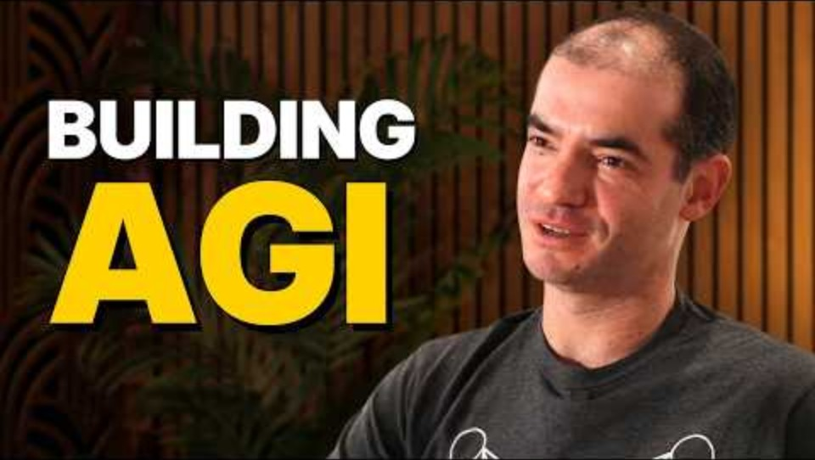
GPT models (“next token”) - Interview with Ilya Sutskever (6:35-8:50)
Sutskever co-founded and was chief scientist at OpenAI (left in 2024). Co-invented AlexNet (a groundbreaking CNN)
https://www.youtube.com/embed/Yf1o0TQzry8?start=395&end=530

Slide 46
Topics Covered - Course Tracker
Week # | Topic
1 | Overview of AI, history, definitions, and key concepts
2 | Knowledge Representation and Reasoning
3 | Introduction to Machine Learning
4 | Neural Networks & Deep Learning
5 | Distributed AI & AI Platforms
6 | Natural Language Processing (NLP)
7 | Computer Vision
8 | Robotics & Embodied AI
9 | AI & Creativity
10 | Applications of AI – Healthcare, Finance, Education, Retail, Marketing, Entertainment
11 | Applications of AI – Biomedical, Agriculture, Transportation, Mining, Manufacturing, Energy
12 | AI and Society, Bias & Fairness in AI
13 | The Future of AI
15 | No Lecture - Final Project Report & Presentation are Due

